Slide 1
Web Science ITWS 4500 Lally Hall Room 102
ITWS 4500

Slide 2
Extending CSS
CSS allows us to create style rules for our output
Sometimes we want to do more – well we always want more right?
We want;

Slide 3
Extending CSS variables
$font-stack: Helvetica, sans-serif;
$primary-color: #333;
body {
font: 100% $font-stack;
color: $primary-color;
}

Slide 4
Extending CSS nesting
nav ul {
margin: 0;
padding: 0;
list-style: none;
}
nav li {
display: inline-block;
}
nav a {
display: block;
padding: 6px 12px;
text-decoration: none;
}
nav {
ul {
margin: 0;
padding: 0;
list-style: none;
}
li { display: inline-block; }
a {
display: block;
padding: 6px 12px;
text-decoration: none;
}
}

Slide 5
Extending CSS mixins
Patterns of property:value pairs which can be reused in later rule sets
Define pattern border-radius with a parameter of the radius
We can set the border radius for all of out browsers with one css definition
@mixin border-radius($radius) {
-webkit-border-radius: $radius;
-moz-border-radius: $radius;
-ms-border-radius: $radius;
-o-border-radius: $radius;
border-radius: $radius;
}
.box { @include border-radius(10px); }

Slide 6
Extending CSS Inheritance/Extending
Define main aspects of a message in class .message
Make successful messages green and errors red
.message {
border: 1px solid #ccc;
padding: 10px;
color: #333;
}
.success {
@extend .message;
border-color: green;
}
.error {
@extend .message;
border-color: red;
}

Slide 7
Extending CSS
and more...
The above examples are Sass - a popular CSS extension/preprocessor
Sass
Requires ruby
Server-side (ish)
Can be compiled and sent down the wire as a library
Another is;

Slide 8
Extending CSS
{LESS}
Javascript library
Client-side (ish)
There is a server-side version
Which is better you might ask?
2 developers = 3 opinions
Either way is that enough?
Nah

Slide 9
Front-end frameworks
Enter Front-end frameworks...
Predefined layouts and setups and methodology for use in creating styles for your output (in our case UI or site)
Lots – LOTS of ‘em
Two of the more popular Bootstrap (from twitter) and Foundation (from Zurb)
Naturally they are both the best!

Slide 10
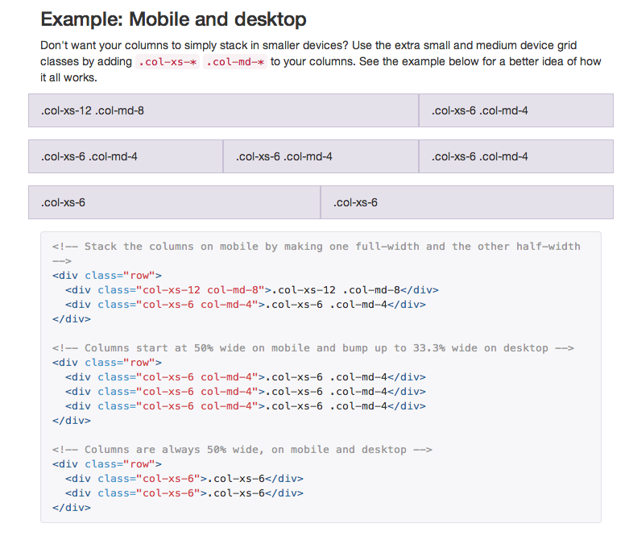
Bootstrap
Mobile first
Grid system
Predefined classes
& mixins

Slide 11
AJAX dataType:
Remember this?
$.ajax({
type: "GET",
url: "lab4.json",
dataType: "json",
success: function(responseData, status) {
var title = '';
var album = '';
var artist = '';
var date = '';
var genre = '';
$.each(responseData.song, function(i, item) {
…
}

Slide 12
AJAX dataType:”jsonp”
What if I want to take data back from another server
Web APIs return JSON data from another domain (Cross Domain) – uh oh...
JSON with Padding
Remember the Facebook API?
https://graph.facebook.com/4?fields=id,name
{
"id": "4",
"name": "Mark Zuckerberg"
}

Slide 13
AJAX dataType:”jsonp”
We use dataType:jsonp to read back json data from another domain or script
So if we are calling a web service API – like Facebook or twitter – we are making our request to a resource
The data that is returned is of type jsonp
dataType:”jsonp”;
url:”https://graph.facebook.com/4?fields=id,name”;

Slide 14
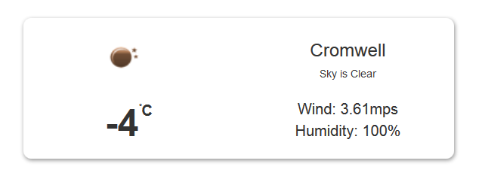
Lab 2
Connect to a weather app of your choice
I.e. OpenWeatherMap or Forecast.io
Use the HTML5 Geolocation API to retrieve the current location from the browser
Pass the location to the API
Populate the weather data (Current and Forecast) in the browser
Use CSS Transitions/Animations to enhance the look and feel of the app – Bootstrap or Foundation

